Slide 1
Phase 1

Slide 2
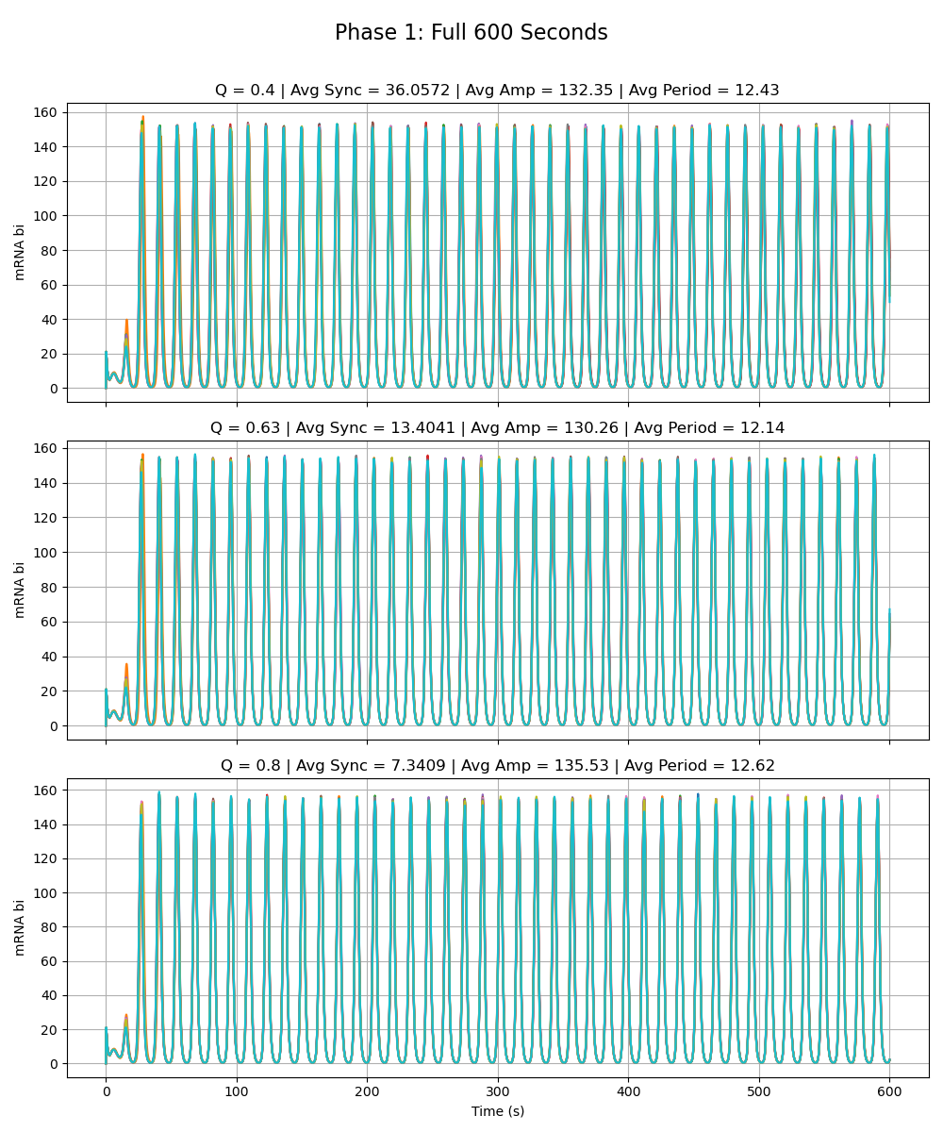
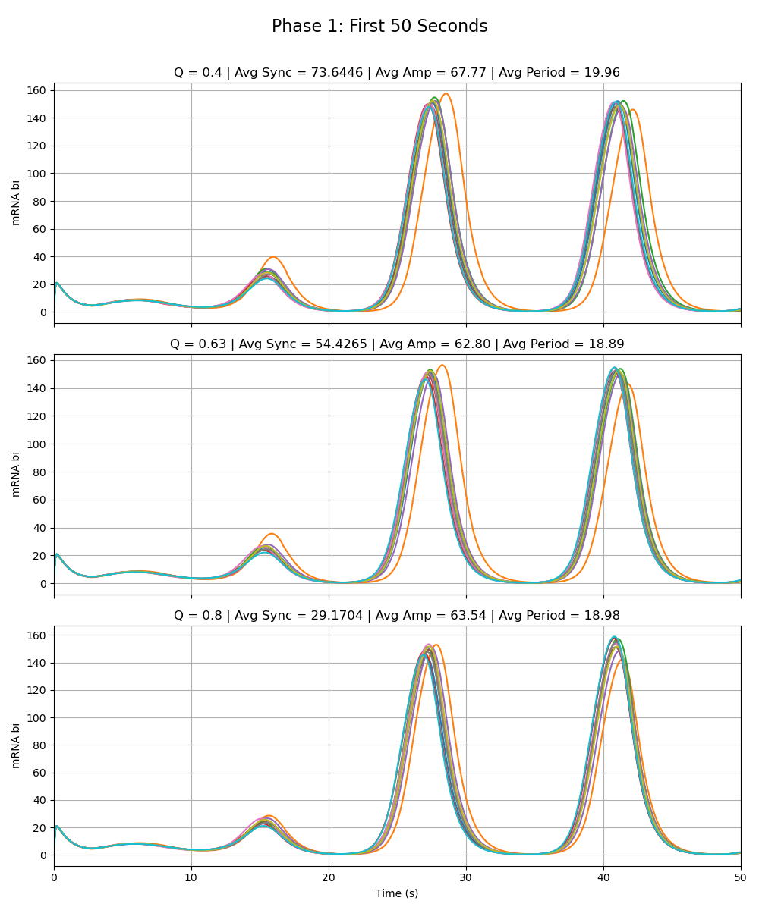
Notes:
Phase 1

Slide 3
Phase 2a - Olivia

Slide 4

Notes:
Phase 2a – added link is very weak (max rate of z transcription is very low 0.01 vs. max rate for the rest as given by paper 216)

Slide 5
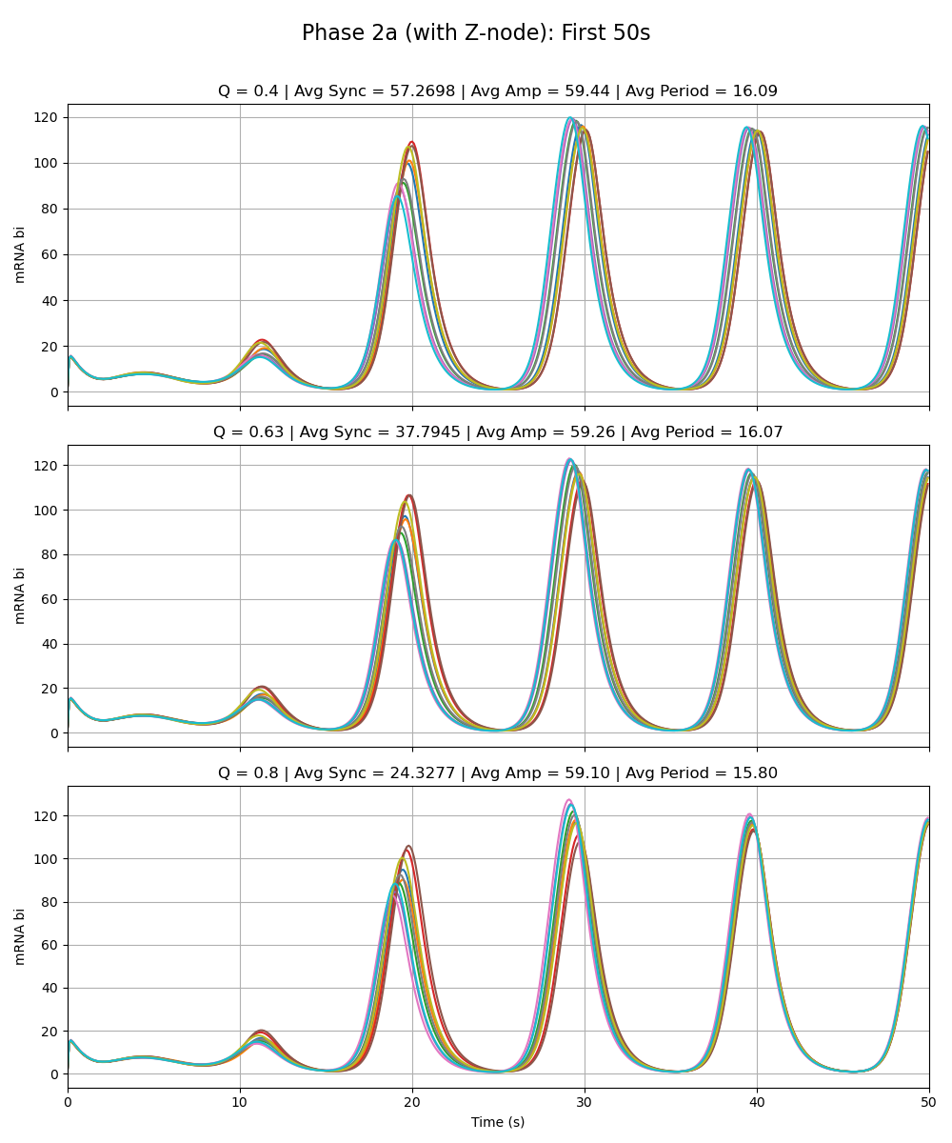
Notes:
Phase 2a – added link is very weak (max rate of z transcription is very low 0.01 vs. max rate for the rest as given by paper 216)

Slide 6
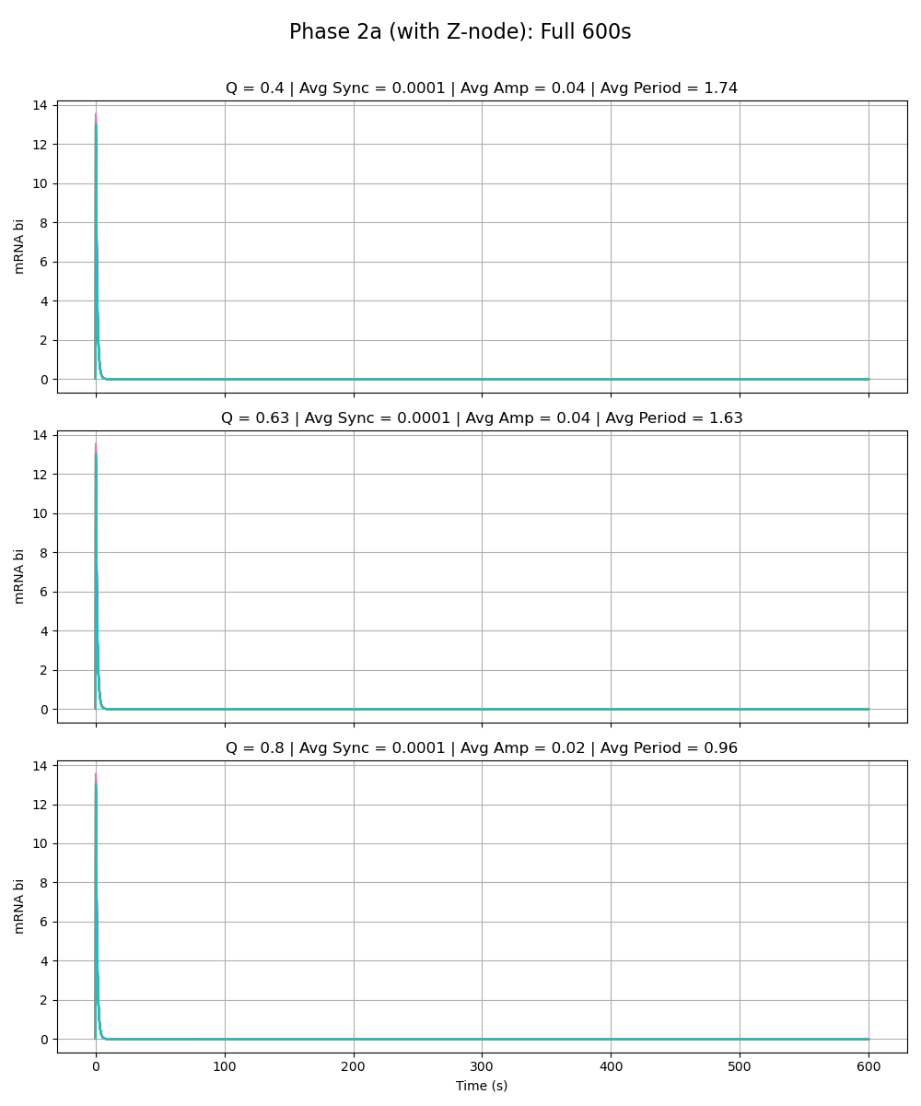
Notes:
Phase 2a – added link is same strength as the rest of the circuit (max rate of z transcription is 216 vs. max rate for the rest as given by paper 216)

Slide 7
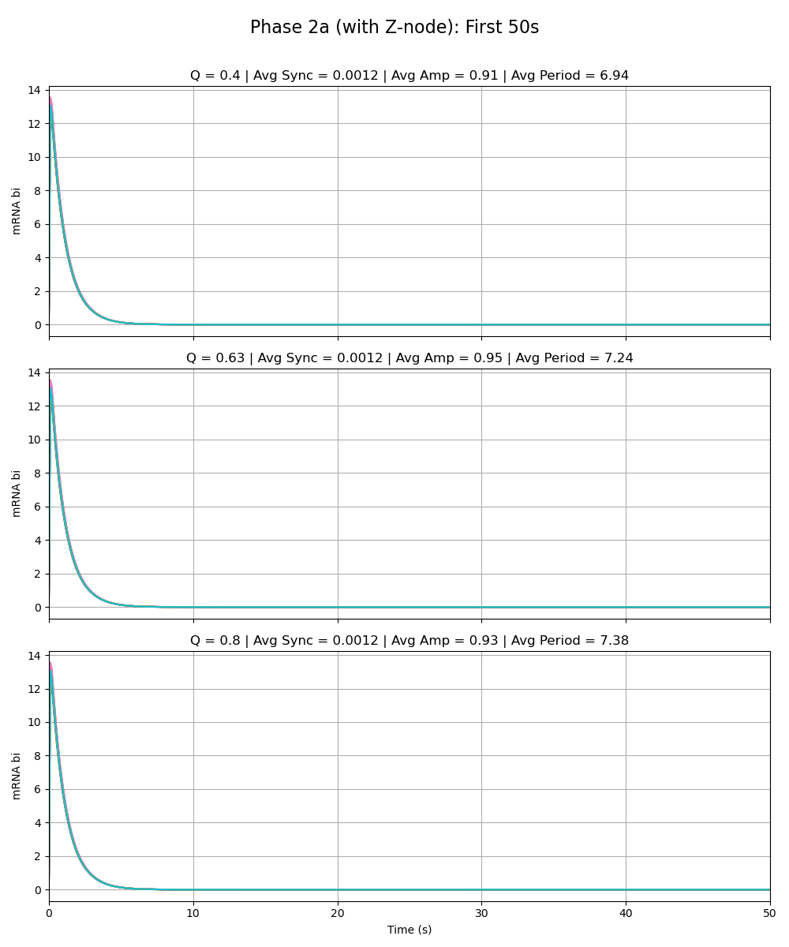
Notes:
Phase 2a – added link is same strength as the rest of the circuit (max rate of z transcription is 216 vs. max rate for the rest as given by paper 216)

Slide 8
Phase 2a - Adriana

Slide 9
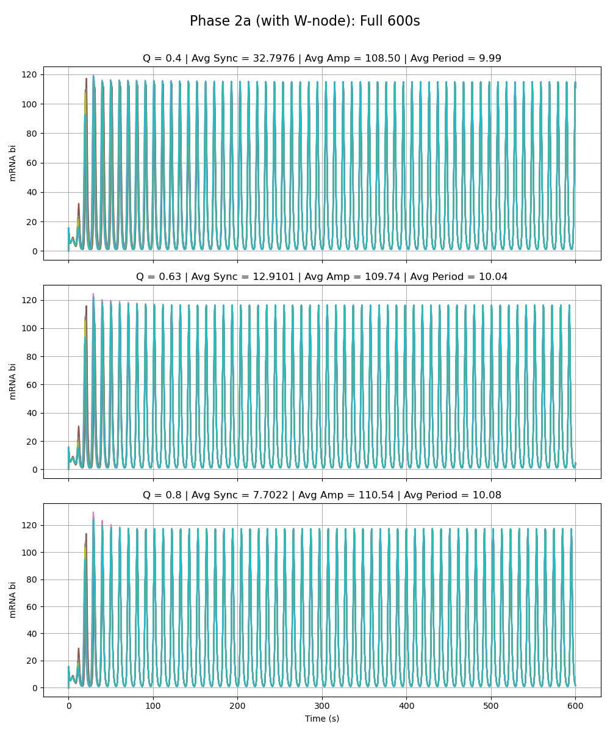
Notes:
Phase 2a – added link is very weak (max rate of w transcription is very low 0.01 vs. max rate for the rest as given by paper 216)

Slide 10
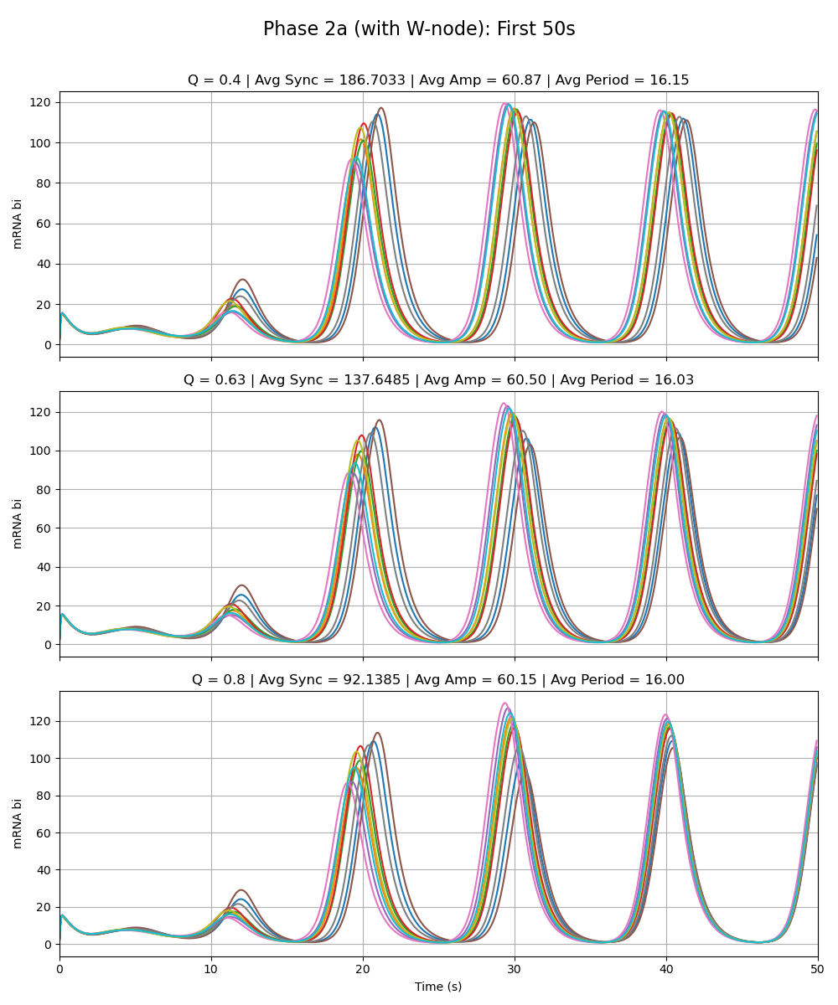
Notes:
Phase 2a – added link is very weak (max rate of w transcription is very low 0.01 vs. max rate for the rest as given by paper 216)

Slide 11
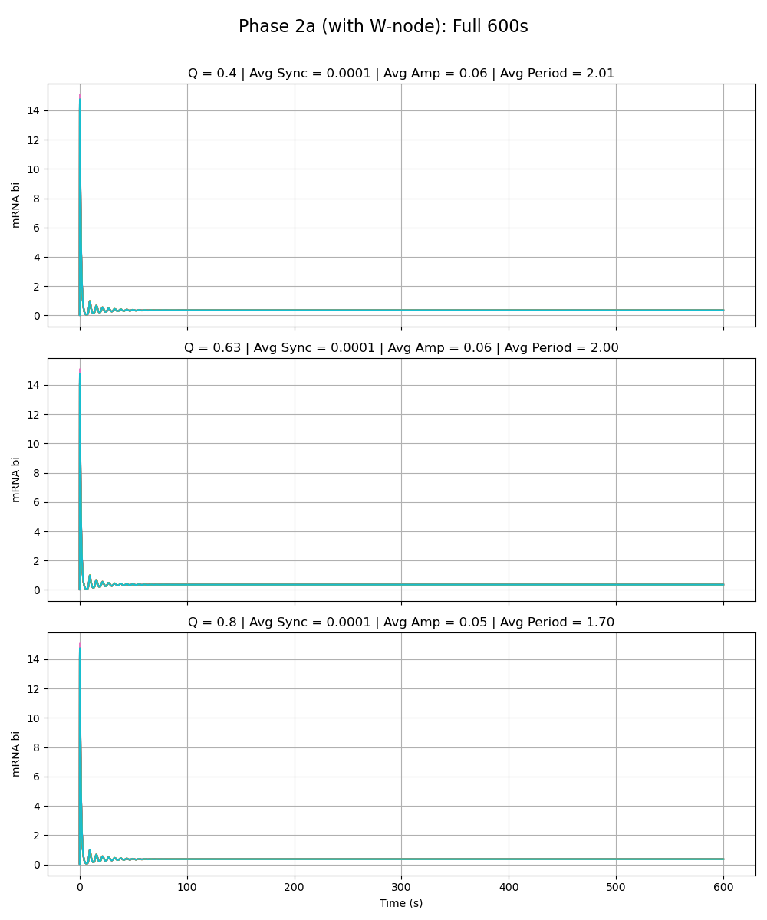
Notes:
Phase 2a – added link is same strength as the rest of the circuit (max rate of w transcription is 216 vs. max rate for the rest as given by paper 216)

Slide 12
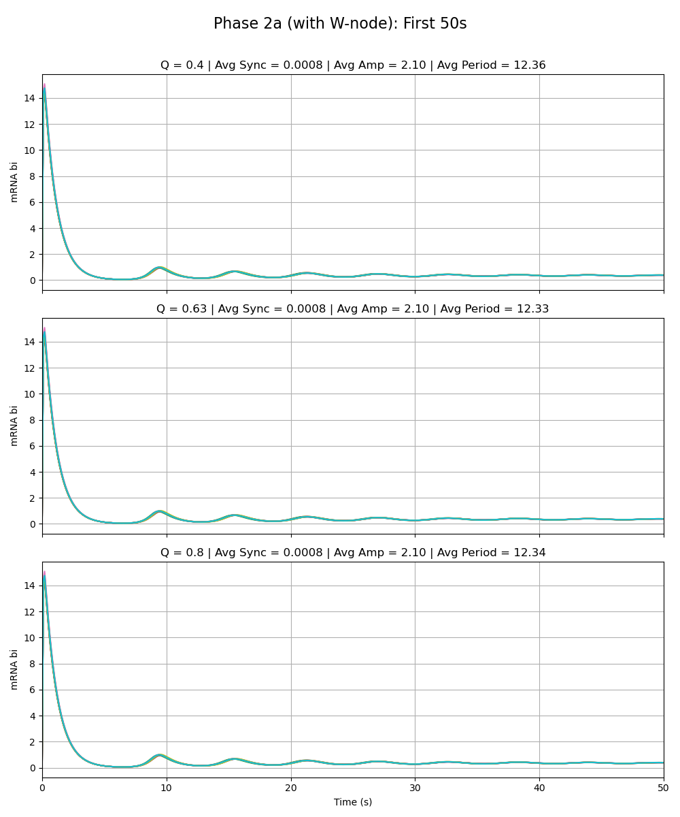
Notes:
Phase 2a – added link is same strength as the rest of the circuit (max rate of w transcription is 216 vs. max rate for the rest as given by paper 216)

Slide 13
Phase 2a - Sydney

Slide 14
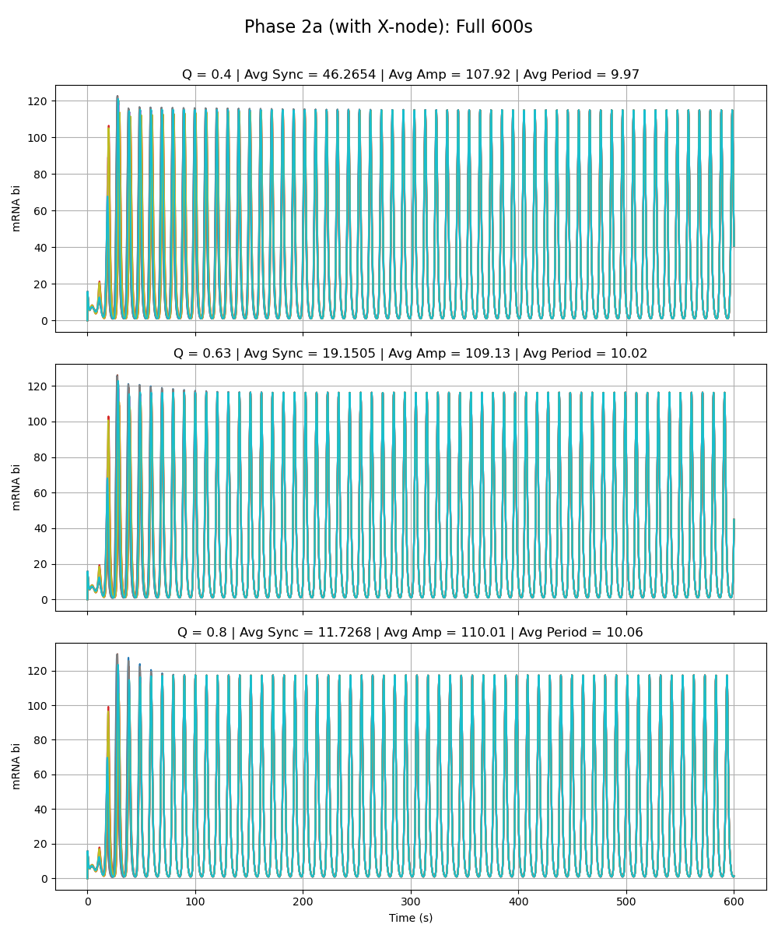
Notes:
Phase 2a – added link is very weak (max rate of x transcription is very low 0.01 vs. max rate for the rest as given by paper 216)

Slide 15
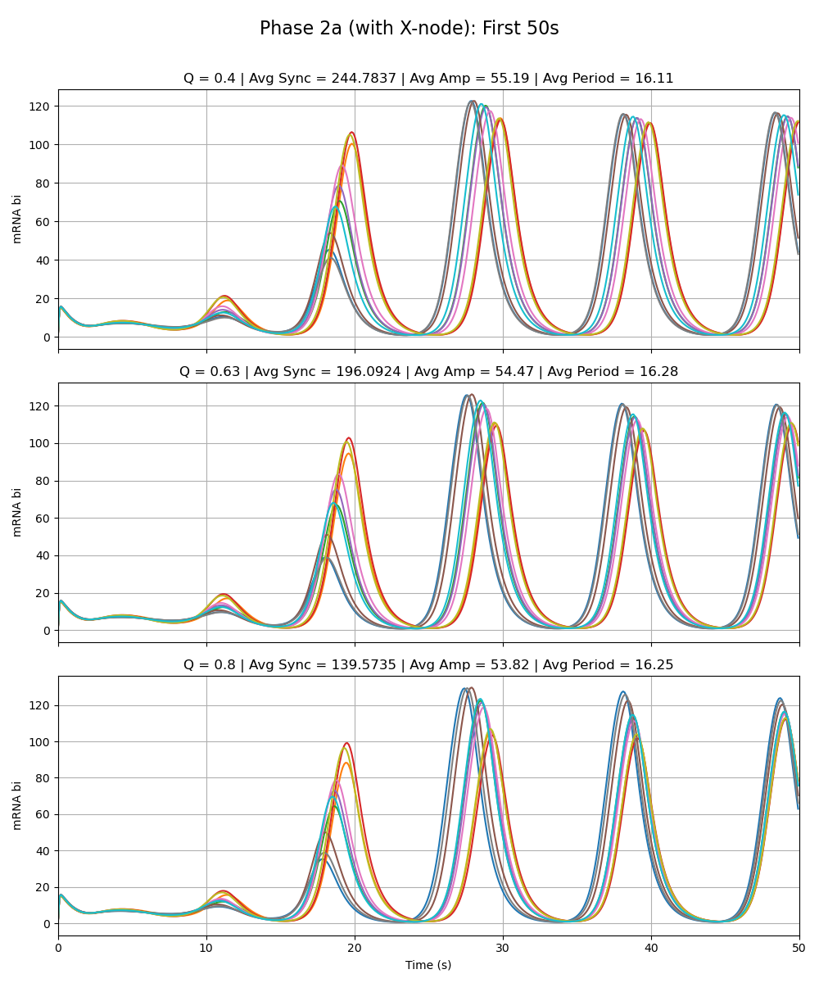
Notes:
Phase 2a – added link is very weak (max rate of x transcription is very low 0.01 vs. max rate for the rest as given by paper 216)

Slide 16
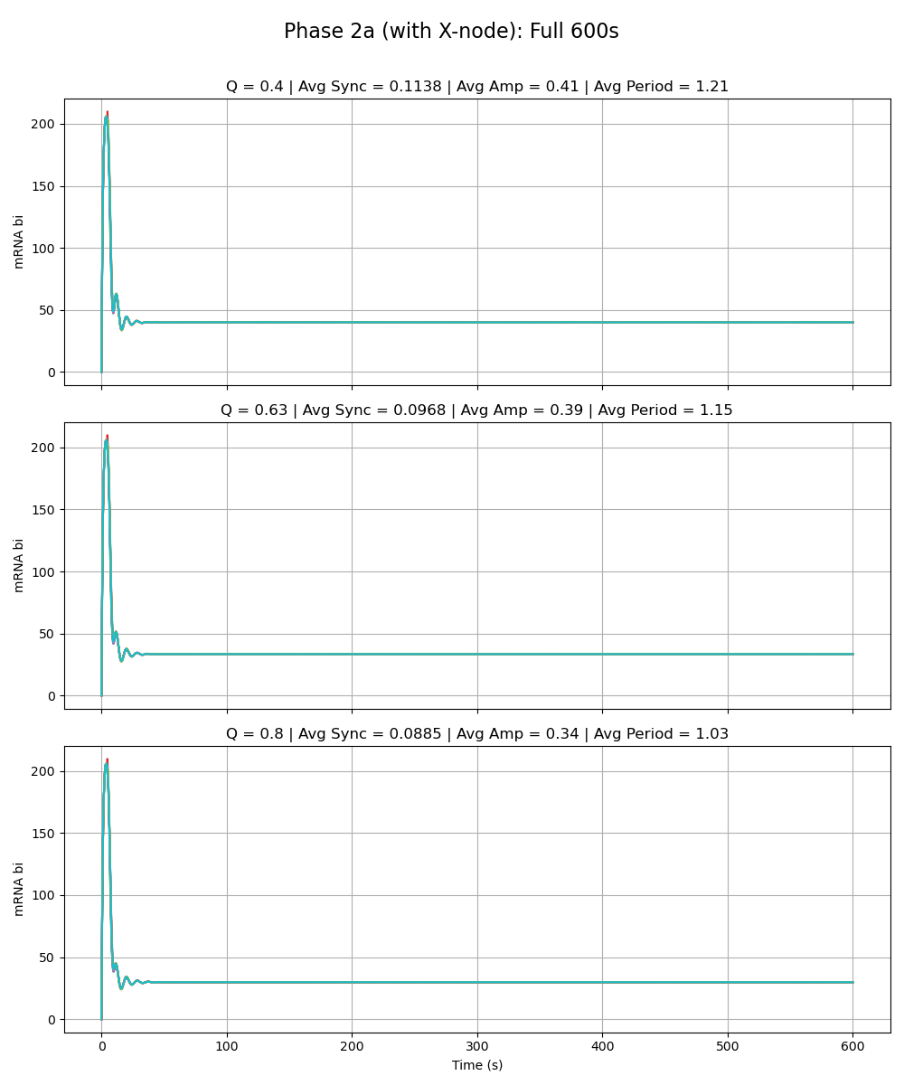
Notes:
Phase 2a – added link is same strength as the rest of the circuit (max rate of x transcription is 216 vs. max rate for the rest as given by paper 216)

Slide 17
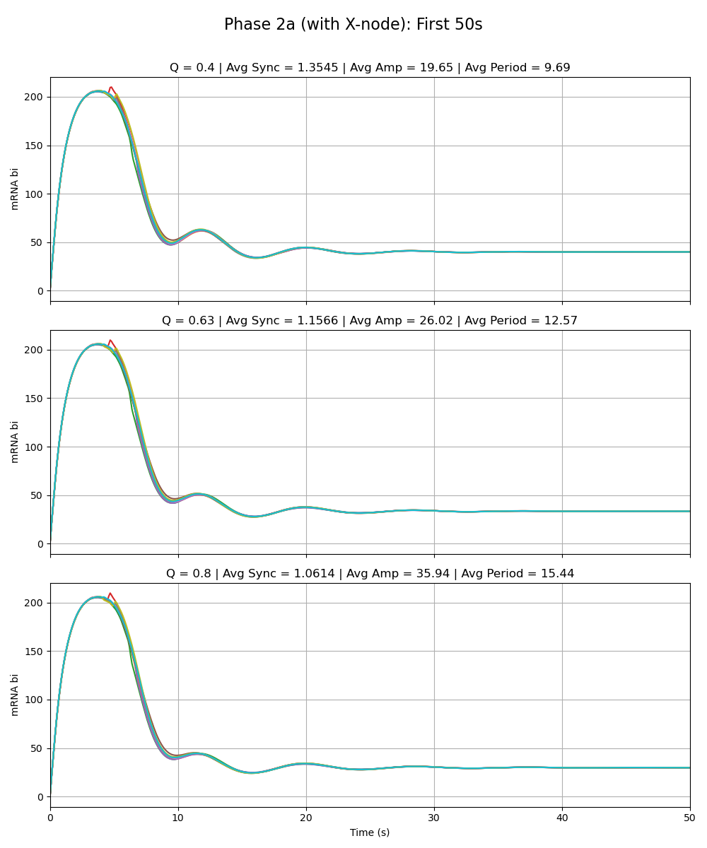
Notes:
Phase 2a – added link is same strength as the rest of the circuit (max rate of x transcription is 216 vs. max rate for the rest as given by paper 216)

Slide 18
Phase 2a - Sean

Slide 19

Notes:
Phase 2a – added link is very weak (max rate of y transcription is very low 0.01 vs. max rate for the rest as given by paper 216)

Slide 20
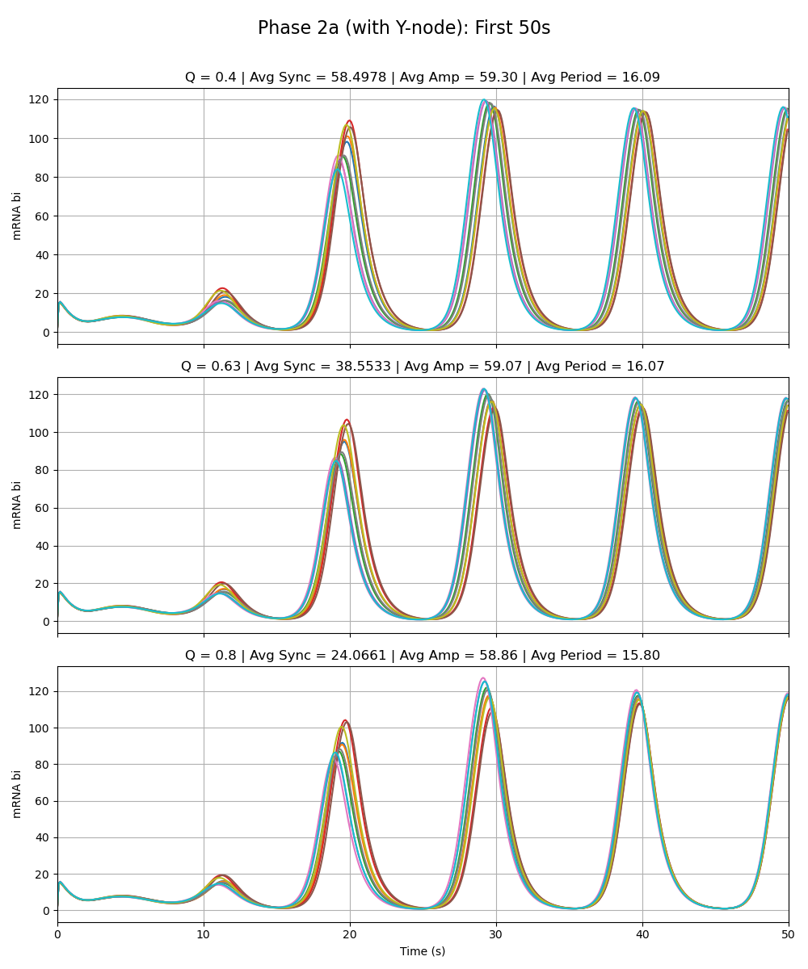
Notes:
Phase 2a – added link is very weak (max rate of y transcription is very low 0.01 vs. max rate for the rest as given by paper 216)

Slide 21
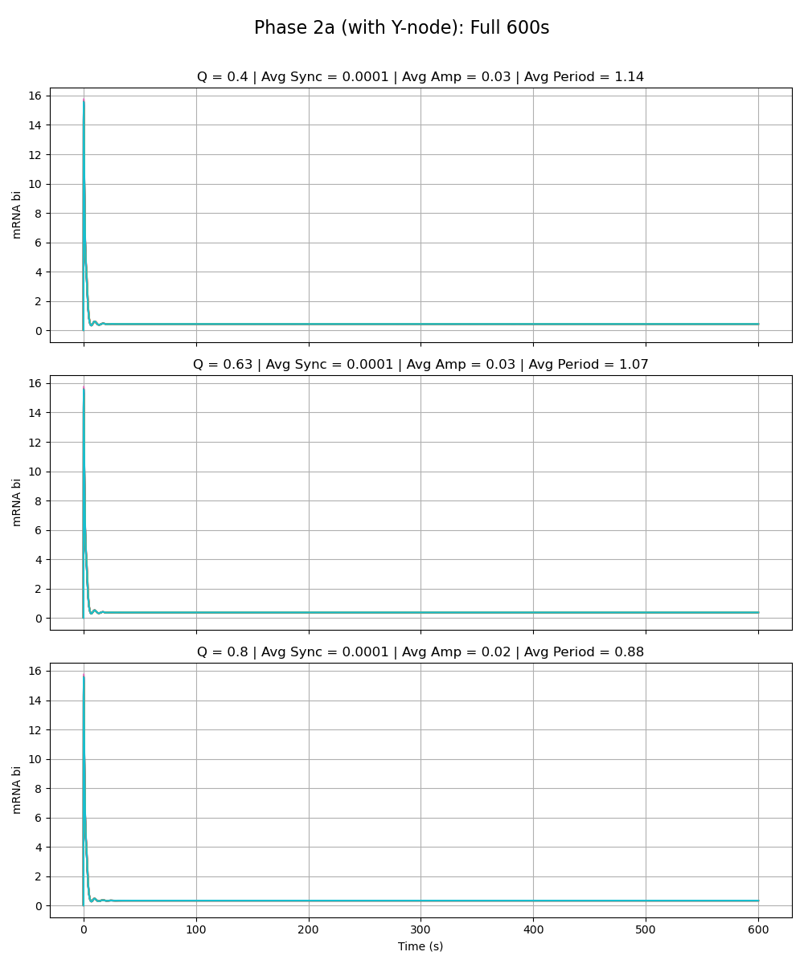
Notes:
Phase 2a – added link is same strength as the rest of the circuit (max rate of y transcription is 216 vs. max rate for the rest as given by paper 216)

Slide 22
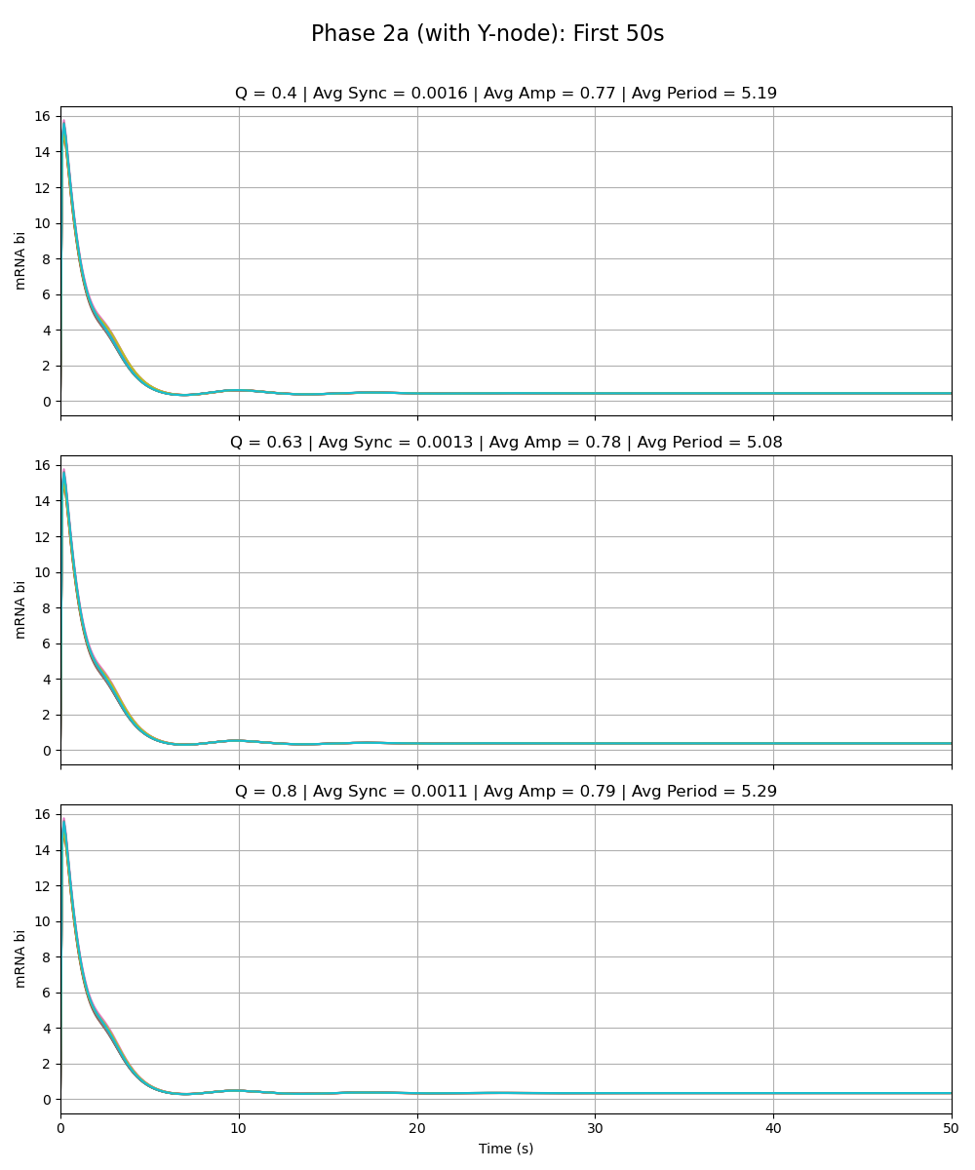
Notes:
Phase 2a – added link is same strength as the rest of the circuit (max rate of y transcription is 216 vs. max rate for the rest as given by paper 216)

